Slide 1
PRO2000 - programming
Week 36- Conditionals, Loops
Gebremariam Assres
Gebremariam.assres@kristiania.no

Slide 2
Today's topics
Selection structures
if
if-else
switch
Iteration structures
for
while
do-while

Slide 3
Overview
The sequence in which instructions are executed is called program flow.
By default, C++ follows a top-to-bottom execution order.
However, control structures are used to determine the order in which program statements are executed.
Control structures alter this sequence to support: decision-making, selection, repetition.
They allow a program to make decisions and perform repeated operations.
Common C++ control structures include: if-else, switch, for, while, do-while
Notes:
This presentation examines the fundamental control structures in C++. These structures are essential because they enable a program to respond intelligently to conditions and to repeat tasks efficiently. Without control structures, programs would execute only in a simple sequential manner.
Program flow is a central concept in programming. In a simple program, instructions are executed one after another. However, real-world applications require more flexibility. Control structures provide that flexibility by allowing branching and looping behavior.
Selection structures are used when a program must choose between alternatives. Iteration structures are used when a set of statements must be executed repeatedly. Understanding the distinction between these categories is important for writing correct and efficient programs.

Slide 4
Conditionals

Slide 5
Relational expressions
Relational expressions are boolean which evaluate to true (1) or false (0)
Examples of expressions, logical operators, precedences:
        Constants:
        12 > 5 is true
        7 <= 5 is false
        Variable like if x is 10, then:
          x == 10 is true,
          x <= 8 is false,
          x != 8 is true, and
          x == 8 is false

Slide 6
Relational expressions …
Examples …
int x = 12, y = 5, z = -4;
• (x > y) && (y > z) | true
(x > y) && (z > y) | false
(x <= z) || (y == z) | false
(x <= z) || (y != z) | true
!(x >= z) | false

Slide 7
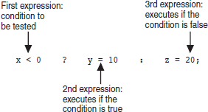
Relational expressions …
Can be assigned to a variable
bool result = (x <= y);
Assigns 0 for false, 1 for true
Conditional operator- expr ? expr : expr;
Do not confuse = (assignment) and == (equal to)

Slide 8
The if Statement
Supports the use of a decision structure
Allows statements to be conditionally executed or skipped over
Models the way we mentally evaluate situations
  “If it is cold outside,
    wear a coat and wear a hat.”
The if statement is used to evaluate a condition.
If the condition is true, one block of code is executed.
If the condition is false, an alternative block is executed.
Notes:
The if statement is one of the simplest and most widely used decision-making structures. It allows a program to select between two possible execution paths based on the truth value of a condition.

Slide 9
The if Statement …
Flow of Control
if (condition) {
// statements if true
}
condition
if (score >= 60)
cout << "You passed." << endl;
if (score >= 90)
{
grade = 'A';
cout << "Wonderful job!" << endl;
}
true
false
1 or more statements

Slide 10
The if Statement …
if is a keyword. It must be lowercase
(condition)must be in ( )
Do not place ; after (condition)
Don't forget the { } around a multi-statement body

Slide 11
The if Statement …
Flag
  A variable that signals a condition
  Usually implemented as a bool but can also be an integer
  Meaning:
    true: the condition exists
    false: the condition does not exist
  The flag value can be both set and tested with if statements
bool validMonths = true;
…
if (months < 0) validMonths = false;
…
if (validMonths)
moPayment = total / months;
int allDone = 0; // set to false …
if (count > MAX_STUDENTS)
allDone = 1; // set to true …
if (allDone)
cout << "Task finished";

Slide 12
The if Statement …
Nested if statement
  … an if statement placed inside the body of another if or else block
  It allows you to test multiple layers of conditions, where the inner condition is evaluated only if the outer condition is true.
int age = 20;
bool hasLicense = true;
if (age >= 18) {
cout << "Age requirement met." << endl;
if (hasLicense) {
cout << "You are allowed to drive!" << endl;
}
}
float score=95;
if (score < 100)
{
if (score > 90)
grade = ‘’A’’
}
cout<<grade<<endl;

Slide 13
The if Statement …
Input validation: inspecting input data to determine if it is acceptable thereby avoiding bad input
Can perform various tests- range, reasonableness, valid menu choice, zero as a divisor, etc.
  Used to test if a value is within a range
  if (grade >= 0 && grade <= 100) cout << "Valid grade";
  Can also test if a value lies outside a range
  if (grade <= 0 || grade >= 100) cout << "Invalid grade";
Cannot use mathematical notation
if (0 <= grade <= 100) //Doesn’t work!

Slide 14
The if Statement …
Scope of a variable is the block in which it is defined, from the point of definition to the end of the block
  Variables defined inside { } have local or block scope
Variables are usually defined at the beginning of a function
They may instead be defined close to the place where they are first used
Can use relational operators with characters and string objects
if (menuChoice == 'A’)
if (firstName == "Beth")
Comparing characters is really comparing ASCII values of characters
Use cctype header to apply functions isalpha, isdigit, islower, isupper, etc.

Slide 15
The if-else Statement …
If (condition) is true, statement set 1 is executed and statement set 2 is skipped.
If (condition) is false, statement set 1 is skipped and statement set 2 is executed.
if (condition)
{
statement set 1;
}
else
{
statement set 2;
}
#include <iostream>
using namespace std;
int main() {
int number = 10;
if (number > 0) {
  cout << "Positive number" << endl;
  }
  else {
  cout << "Non-positive number" << endl;
  }
  return 0;
}
Notes:
In this example, the variable number is assigned the value 10. Since the condition number > 0 evaluates to true, the first output statement is executed. If the value had been zero or negative, the else block would have been executed instead.

Slide 16
The if-else Statement …
if/else chain with Trailing else
if (age | >= 21)
cout | << "Adult";
else if | (age >= 13)
cout | << "Teen";
else if | (age >= 2)
cout | << "Child";
else
cout | << | "Baby";

Slide 17
The switch Statement
The switch statement enables multi-way selection to compare an expression against a set of constant case values.
It is often preferred over multiple if-else if statements when testing one variable.
IntExpression must be a char or an integer variable or an expression that evaluates to an integer value
exp1 through expn must be constant integer type expressions and must be unique
default is optional but recommended
Use break; statement to stop execution in the current block or to exit a switch statement
switch (IntExpression)
{
case exp1: statement set 1;
break;
case exp2: statement set 2;
break;
...
case expn: statement set n;
break;
default: statement set n+1;
}
Notes:
The switch statement provides a clear and structured way to handle multiple possible values of a single expression. Each case represents a possible match. The break statement is important because it prevents the execution of subsequent cases.

Slide 18
The switch Statement …
#include <iostream>
using namespace std;
int main() {
int choice = 2;
switch (choice) {
case 1:
cout << "Choice is 1" << endl;
break;
case 2:
cout << "Choice is 2" << endl;
break;
default:
cout << "Invalid choice" << endl;
break;
}
return 0;
}
Example of switch
Notes:
In this example, the variable choice is equal to 2. The program checks the available cases and finds that case 2 matches the expression. Therefore, it prints "Choice is 2". If no case matched, the default block would handle the situation.

Slide 19
The switch Statement …
switch is a natural choice for menu-driven program
  display menu
  get user input
  use user input as IntExpression in switch statement
  use menu choices as exp to test against in the case statements
Use enumerated types in switch statements
  Format: enum class name {val1, val2, … valn};
  Examples:
        enum class Fruit {apple, grape, orange};
        enum class Days {Mon=1, Tue, Wed, Thur, Fri}

Slide 20
Loops

Slide 21
The for Loop
The for loop is used when the number of iterations is known in advance.
It combines initialization, condition checking, and update in a single statement.
It is widely used for counting operations.
Use counter variables, sentinels, nested loops
Initialization and update code can contain more than one statement separated by commas
for (int sum=0, num=1; num<=10; num++) sum+=num;
Notes:
The for loop is especially useful in situations where repetition follows a predictable pattern, such as iterating through a range of numbers. Its compact structure makes it easy to understand and maintain.

Slide 22
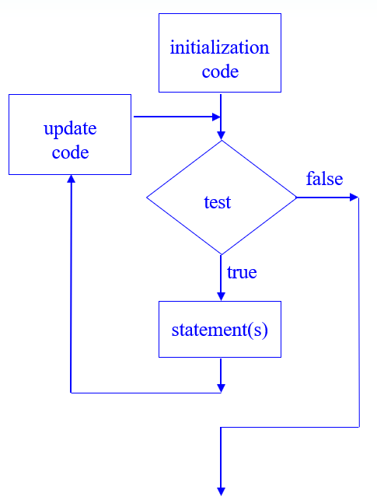
The for Loop …
for (initialization; condition; update) {
// repeated statements
}
Notes:
The for loop is especially useful in situations where repetition follows a predictable pattern, such as iterating through a range of numbers. Its compact structure makes it easy to understand and maintain.

Slide 23
The for Loop …
Exampl 2
Exampl 1
int sum = 0, num;
for (num = 1; num <= 10; num++)
sum += num;
cout << "Sum of numbers 1 – 10 is "
<<sum<<endl;
#include <iostream>
using namespace std;
int main() {
cout << "For Loop Output: ";
for (int i = 0; i < 5; i++) {
cout << i << " ";
}
cout << endl;
return 0;
}
Notes:
This example demonstrates a for loop that begins with i = 0 and continues while i < 5. After each iteration, i is incremented by one. As a result, the output produced is 0 1 2 3 4.

Slide 24
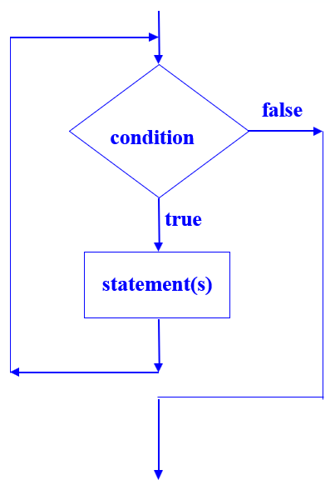
The while Loop
The while loop repeats a block of code as long as a condition remains true.
It is suitable when the number of iterations is not known beforehand.
The condition is tested before the loop body is executed.
while (condition) {
// repeated statements
}
Notes:
The while loop is referred to as an entry-controlled loop because the condition is checked at the beginning of each iteration. If the condition is false initially, the body of the loop will not execute even once.

Slide 25
The while Loop …
Example of while Loop
#include <iostream>
using namespace std;
int main() {
cout << "While Loop Output: ";
int count = 0;
while (count < 5) {
cout << count << " ";
count++;
}
cout << endl;
return 0;
}
int val = 5; while (val >= 0)
{ cout << val << " "; val = val - 1;
}
produces output:
5 4 3 2 1 0
Notes:
In this example, the variable count starts at 0. The loop continues as long as count is less than 5. During each iteration, the current value is displayed and then incremented. The final output is 0 1 2 3 4.

Slide 26
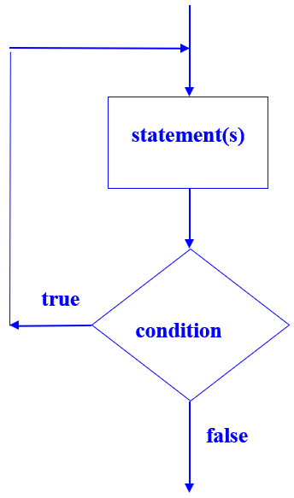
The do-while Loop
The do-while loop is similar to the while loop.
However, the condition is evaluated after the loop body executes.
Therefore, the loop body always executes at least once.
do {
// repeated statements
} while (condition);
Notes:
The do-while loop is called an exit-controlled loop because the condition is tested after execution of the body. This makes it appropriate in cases where at least one execution is required before checking the continuation condition.

Slide 27
The do-while Loop …
Example of do-while Loop
Menu-Driven Program Example
do {
// code to display menu
// and perform actions
cout << "Another choice? (Y/N) ";
} while (choice =='Y'||choice =='y');
The condition could be written as
(toupper(choice) == 'Y');
or as
(tolower(choice) == 'y');
#include <iostream>
using namespace std;
int main() {
cout << "Do-While Loop Output: ";
int num = 0;
do {
cout << num << " ";
num++;
} while (num < 5);
cout << endl;
return 0;
}
Notes:
In this example, the variable num begins at 0. The loop prints the current value, increments it, and then checks whether num < 5. This process continues until the condition becomes false. The output is 0 1 2 3 4.

Slide 28
Summary
Elements of Conditional Structures
  Condition- A logical expression that evaluates to true or false
  Execution block- The statements performed when a condition is satisfied
  Alternative block- The statements performed when a condition is not satisfied
  Case labels- Specific constant values used in a switch
  Default case- Executed when no case label matches
Notes:
Conditional structures are based on logical evaluation. In if-else, the result of the condition determines which code block executes. In switch, the expression is compared against multiple case labels. The default case acts as a fallback when no match is found.

Slide 29
Summary …
Elements of Iteration Structures
  Initialization- Establishes the starting state of the loop
  Condition- Determines whether another iteration should occur
  Loop body- Contains the statements to be repeated
  Update- Modifies the loop variable or state
  Termination- Occurs when the condition evaluates to false
Notes:
All loop structures share common components. Initialization defines the starting point, the condition controls continuation, and the update moves the loop toward completion. These elements are essential to prevent unintended infinite loops and to ensure correct program behavior.

Slide 30
Up next: Exercises
Now: 2 hours (12:15 to 14:00) of exercises (found on Canvas).
Short exercise summary:
  Write, compile, and debug a C++ programs with emphasis on statements formed by if, if-else, switch, for, while, and do-while
Remember:
  You should do approximately 4 more hours of the course (in a study group or alone) before our next session together. :-)

